Slide 1
Math 152 – Lesson 16
Lesson | Topic | Reading | Homework
M13 | Partial Fractions | 7.4 | 1, 7, 19
M14 | Improper Integrals | 7.8 | 5,13
M15 | Work/Avg Value of a Function | 6.4/6.5 | 6.4: 1516,19,21 6.5: 7,9
Upcoming Suspenses
25 Sep | FSPA / Quiz 2
7 Oct | HW Set #3

Slide 2
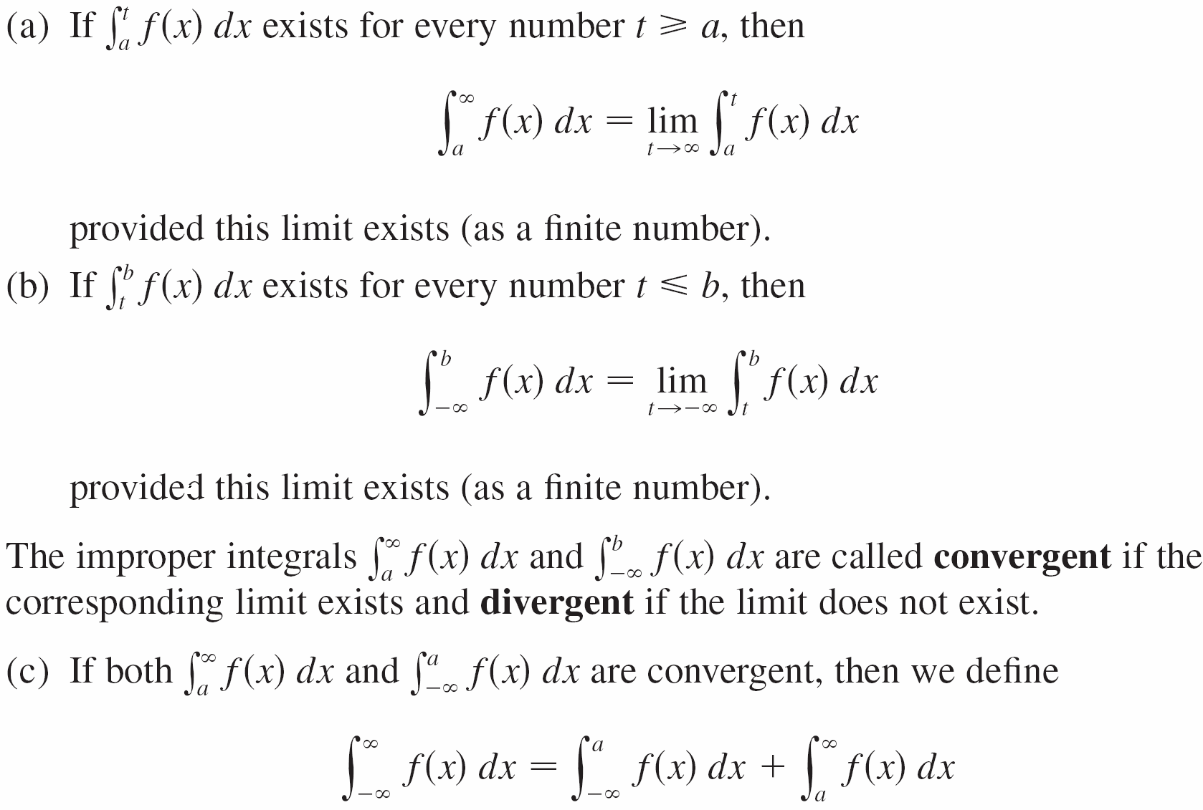
Type 1: Infinite Intervals

Slide 3
Type 2: Discontinuous Integrands

Slide 4
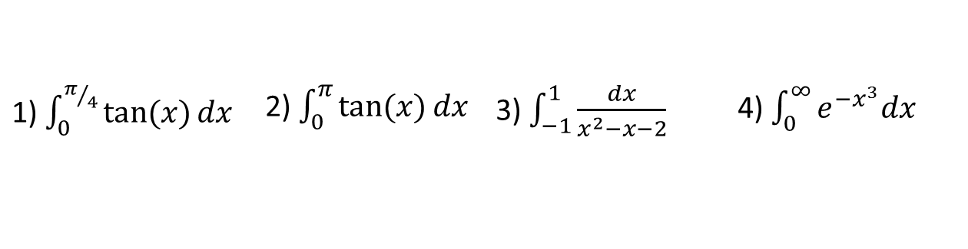
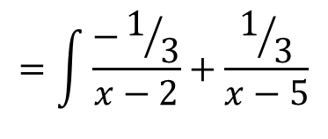
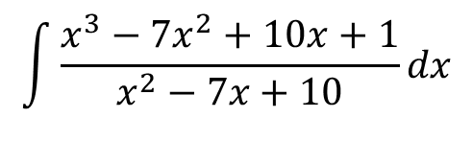
Board Work
Which of the following integrals are improper? Why?
State the type of improper integral and determine whether each integral is convergent or divergent. Evaluate those that are convergent.
Cadet slowpoke runs the strips of the terrazzo at the rate, $r\left(t\right)=\frac{10t}{e^{t^{2}}}$ miles per hour, where $t$ is in hours. If cadet slowpoke’s training officer tells him to run forever, how far will he actually run?
Lemonade is drained from a cooler at a rate $r\left(t\right)=\frac{3t}{e^{t}}$ liters per hour, where $t$ is in hours. If the spigot is left open, how much lemonade will be drained from the cooler in the long run?
1) $\int_{0}^{π/4}{\tan{(x)}dx}$ | 2) $\int_{0}^{π}{\tan{(x)}dx}$ | 3) $\int_{−1}^{1}{\frac{dx}{x^{2}−x−2}}$ | 4) $\int_{0}^{∞}{e^{{−x}^{3}}dx}$
5) $\int_{−∞}^{0}{\frac{1}{3−4x}dx}$ | 6) $\int_{2}^{∞}{\frac{dv}{v^{2}+2v−3}}$ | 7) $\int_{2}^{3}{\frac{1}{\sqrt{3−x}}dx}$

